Slide 1

Beyond the numbers: insights that fuel performance.
Notes:
Today, I’ll be walking you through the latest business performance results for Organics. While the company has delivered strong overall sales of 9.35M and profits of 5.07M, our analysis highlights both strengths to leverage and critical gaps to address.”

Slide 2

Agenda
01
02
03
04
05
06
07
08
Welcome & Objectives
Report Overview
Data & Methodology
Visual Findings
Challenges & Gaps
Recommendations
Strategic Alignment
Q & A
Set the purpose of the session
Align Expectations
Key Findings
Clear Insights
Source of data explained
Analytical approach outlined
Charts and dashboards
Simplified comparisons
Metrics
Areas for Improvement
Key Limitations
Solutions to address the challenges and gaps.
Short-term actions
Long-term roadmap
Alignment with goals
Clarify findings
Gather feedback
Open dialogue
Notes:
The objective is to provide executives with a clear overview of Organics’ current business performance, highlight key challenges and gaps, and present actionable strategies to sustain profitability, reduce risks, and drive balanced growth across products, regions, and customer segments.

Slide 3
Report Overview 02
Value of the market share
$9.35m
$9.35m
Total Sales
Total cost of the goods sold(COGS) $4.28m
$4.28m
Total Cost
Total Profit = Total Sales – Total Cost
$5.07m
$5.07m
Total Profit
Total Customers
378k
Total Customers
378k
Notes:
Sales performance has remained relatively stable from January to June, averaging around $1.5M–$1.6M monthly
“At a high level, Organics is achieving impressive profit margins of 54% and a healthy customer base of 378K. However, much of our performance is concentrated in a few product lines such as Smooth Silky Salty, Peanut Butter Cubes, and Choco Almonds. This concentration creates risk, as weaker or negative contributors like After Nines or Baker’s Chips pull down our overall portfolio.”

Slide 4
Sales Records Analyzed
Analyzed 9.35M in total sales across products, regions, and sales teams.
Reviewed 378K customer records to assess reach and profitability.
Evaluated monthly, regional, and product-level sales trends for growth opportunities
Benchmarked performance using profit %, profit margin, and variance per box.
Data & Methodology 03
DAX Calculations Applied
Created measures for Total Sales, Total Cost, and Total Profit to unify reporting.
Developed Profit % and Profit Margin calculations for performance tracking.
Applied Seasonality Index (SI) to detect monthly demand fluctuations.
Built Rolling 6-Month Average Sales to smooth trends and forecast sustainability.
Used relative profit % and contribution % per product to highlight top/bottom performers.
Validated Visuals
Data cleaned, transformed, and visualized through interactive dashboards to ensure accuracy, usability, and actionable outcomes.
Notes:
In summary, the process moved us from raw sales records, through structured calculations, into validated visuals that highlight both opportunities and risks for Organics.

Slide 5

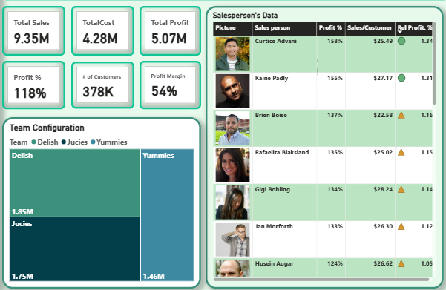
Executive Summary
Notes:
“At Organics, we started by reviewing over 9.35 million in sales records supported by 378,000 customer transactions. The data was segmented by product, region, and sales teams to identify where sales were strong, where costs were rising, and how customers were distributed. This gave us the foundation to assess both the scale and direction of our performance.”

Slide 6
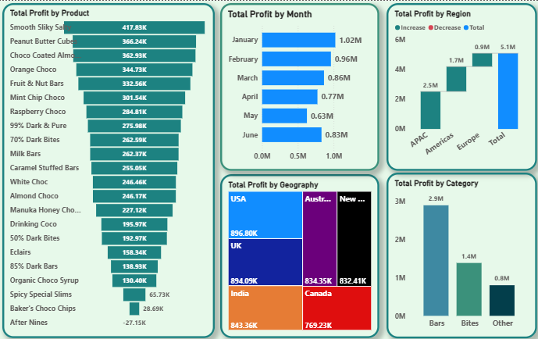
Insight on Profit

Slide 7
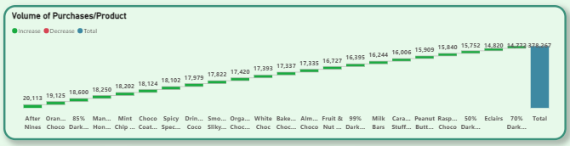
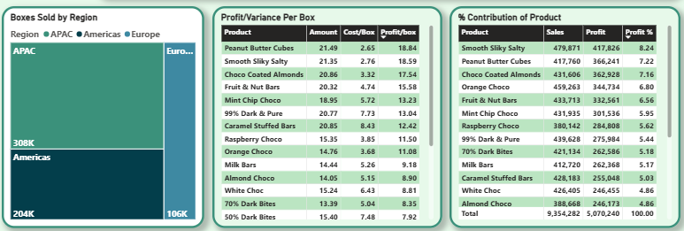
Insight on Products

Slide 8
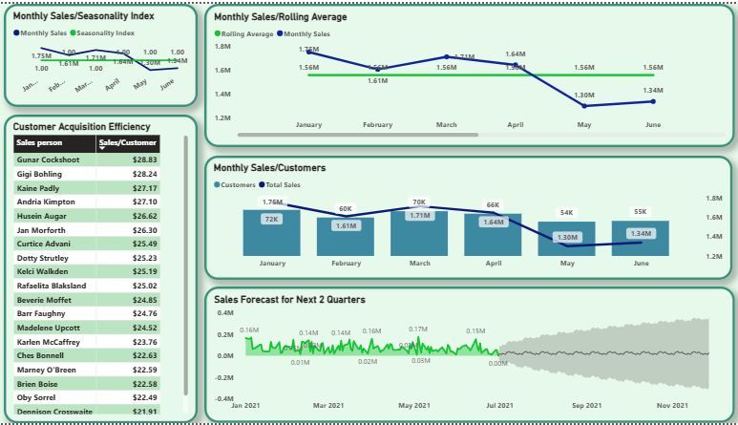
Insight on Sales
Notes:
Sales performance has remained relatively stable from January to June, averaging around $1.5M–$1.6M monthly.
Customer acquisition shows fluctuations, with a dip in March and June.
Seasonality and rolling averages suggest predictable patterns but limited growth acceleration.
Salesperson efficiency varies, with a notable gap between top and bottom performers.
Forecasted sales for the next two quarters show moderate growth with uncertainty.

Slide 9
Challenges & Gaps 05
01
Sales Distribution
Flat Sales Trend
04
Forecast Uncertainty
Underutilized Seasonality Insights
02
Customer Volatility
Customer Profitability
05
Category Mix
Profit Variability
03
06
Regional Imbalance.
Seasonal Declines
Efficiency Disparity
Challenges & Gaps
Notes:
• Flat Sales Trend: Despite seasonal fluctuations, monthly sales are plateauing with no clear upward momentum.
• Sales Distribution: Performance is heavily concentrated in a few top products (Smooth Silky Salty, Peanut Butter Cubes, Choco Almonds) → risk of overdependence.
• Customer Volatility: Significant drop in customer numbers in March and June, impacting overall sales.
• Customer Profitability: Sales per customer are relatively low despite high volume of customers (378K).
Efficiency Disparity: Wide gap in Sales/Customer efficiency between top performer ($28.83) and others (~$23.30).
• Forecast Uncertainty: Confidence interval in forecast suggests potential risk in meeting targets.
• Underutilized Seasonality Insights: Seasonality index is consistent but not leveraged for campaign timing or resource allocation.
Category Mix: Bars dominate profit contribution, while Bites and Others underperform.
• Profit Variability: Some products have negative or very low contribution margins (e.g., After Nines, Baker’s Chips).
• Regional Imbalance: APAC significantly leads, while Americas and Europe lag in sales and box volumes.
• Seasonal Declines: Profit by month shows a downward trend from January (1.02M) to May (0.63M), before a partial recovery in June.

Slide 10
Recommendations 06
Product
Seasons
Diversify Product Portfolio
Category Development
Optimize Underperforming SKUs
Seasonal Planning
Seasonal Campaigns
03
04
02
Customer
Analytics
Regional Growth Push
Customer Value Focus
Targeted Customer Growth
Recommendations
Forecast Calibration
Rolling Average Monitoring
Salesforce Optimization
01
Notes:
Diversify Product Portfolio: Reduce dependency on top sellers; improve marketing and pricing for mid-tier and low-performing products.
Category Development: Invest in innovation and promotion of Bites and Other categories to capture new demand.
Optimize Underperforming SKUs: Reassess pricing, production costs, or discontinue negative/low-margin products.
Regional Growth Push: Strengthen marketing, distribution, and partnerships in the Americas and Europe to balance global performance.
Customer Value Focus: Implement loyalty programs and upselling strategies to boost sales/customer metric.
Targeted Customer Growth: Focus on increasing customer base during low-performing months (e.g., March, June).
Seasonal Planning: Create targeted campaigns to sustain sales momentum beyond Q1 peak.
Seasonal Campaigns: Align marketing and promotions with high-index months (February, May) to maximize ROI.
Salesforce Optimization: Analyze top performer behaviors (Gerard Cockshoot) and replicate best practices across team.
Forecast Calibration: Use predictive analytics to refine forecast models and reduce uncertainty.
Rolling Average Monitoring: Set monthly targets that exceed rolling average to push growth.

Slide 11
Strategic Alignment 07
Customer Retention Program
Data-Driven Marketing
Sales Training & Incentives
Regional Strategy
Product
Operations
Product Strategy
Customer Engagement Strategy
Quarterly Sales Sprints
Operational Strategy
Online and Offline Marketiing
Growth Strategy
Notes:
Customer Retention Program: Launch loyalty and referral programs to stabilize customer count.
Sales Training & Incentives: Implement performance-based incentives and training modules to close efficiency gaps.
Data-Driven Marketing: Use seasonality and customer behavior data to time campaigns and offers.
Quarterly Sales Sprints: Introduce focused sales drives aligned with forecasted dips to mitigate risk.
Executive Dashboards: Build real-time dashboards for leadership to monitor KPIs and intervene proactively.
Product Strategy: Launch limited editions and bundle offers to boost weaker SKUs.
Regional Strategy: Expand supply chain efficiency and market penetration in underperforming regions with localized campaigns.
Customer Engagement Strategy: Personalize offers using data analytics; build retention through reward systems.
Operational Strategy: Streamline costs on low-margin products while reallocating resources to high-profit categories.
Growth Strategy: Explore new geographies and digital channels for broader customer reach.

Slide 12
Thank you for your time.
In summary, Organics is in a strong financial position, but future growth requires deliberate action. By executing on these strategies, we will not only secure our leadership in the APAC market but also unlock new opportunities globally, ensuring sustained profitability and brand strength.
Adeola Enomhensike Data Scientist 📧 dayolah@gmail.com | 📞 4168758725 | 💼 www.linkedin.com/in/adeola-enomhensike
Data. Insight. Action. Impact.
Questions
& Answers 08

